Slide 1
Limitations for Quantum PCPs
Fernando G.S.L. Brandão
University College London
Based on joint work arXiv:1310.0017 with
Aram Harrow
MIT
CEQIP 2014

Slide 2
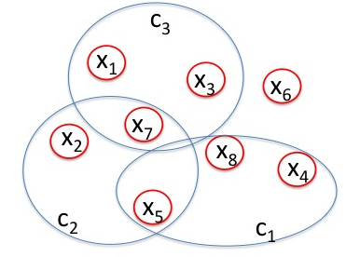
Constraint Satisfaction Problems
(k, Σ, n, m)-CSP :
k: arity
Σ: alphabet
n: number of variables
m: number of constraints
Constraints: C_{j} : Σ^{k} -> {0, 1}
Assignment: σ : [n] -> Σ

Slide 3
Quantum Constraint Satisfaction Problems
(k, d, n, m)-qCSP H
k: arity
d: local dimension
n: number of qudits
m: number of constraints
Constraints: P_{j} k-local projection
Assignment: |ψ> quantum state
(k, Σ, n, m)-CSP : C
k: arity
Σ: alphabet
n: number of variables
m: number of constraints
Constraints: C_{j} : Σ^{k} -> {0, 1}
Assignment: σ : [n] -> Σ

Slide 4
Quantum Constraint Satisfaction Problems
(k, d, n, m)-qCSP H
k: arity
d: local dimension
n: number of qudits
m: number of constraints
Constraints: P_{j} k-local projection
Assignment: |ψ> quantum state
(k, Σ, n, m)-CSP : C
k: arity
Σ: alphabet
n: number of variables
m: number of constraints
Constraints: C_{j} : Σ^{k} -> {0, 1}
Assignment: σ : [n] -> Σ
min eigenvalue
Hamiltonian

Slide 5
Quantum Constraint Satisfaction Problems
Ex 1: (2, 2, n, n-1)-qCSP on a line
j j+1
P_{j, j+1}

Slide 6
Quantum Constraint Satisfaction Problems
Ex 1: (2, 2, n, n-1)-qCSP on a line
j j+1
P_{j, j+1}
Ex 2: (2, 2, n, m)-qCSP with diagonal projectors:
m
m

Slide 7
PCP Theorem
PCP Theorem (Arora, Safra; Arora-Lund-Motwani-Sudan-Szegedy ’98) There is a ε > 0 s.t. it’s NP-hard to determine whether for a CSP, unsat = 0 or unsat > ε
Compare with Cook-Levin thm:
It’s NP-hard to determine whether unsat = 0 or unsat > 1/m.
- Equivalent to the existence of Probabilistically Checkable Proofs
for NP.
- (Dinur ’07) Combinatorial proof.
Central tool in the theory of hardness of approximation.

Slide 8
Example: Graph Coloring

Slide 9
Quantum Cook-Levin Thm
Local Hamiltonian Problem
Given a (k, d, n, m)-qcsp H with constant k, d and m = poly(n), decide if unsat(H)=0 or unsat(H)>Δ
Thm (Kitaev ‘99) The local Hamiltonian problem is
QMA-complete for Δ = 1/poly(n)
QMA is the quantum analogue
of NP, where the proof and the
computation are quantum.
locality
local dim
….
U₄
U₅
U₃
U₂
U₁
input
proof

Slide 10
Quantum PCP?
The Quantum PCP conjecture: There is ε > 0 s.t. the following problem is QMA-complete: Given (2, 2, n, m)-qcsp H determine whether
(i) unsat(H)=0 or (ii) unsat(H) > ε.
locality
local dim
(Bravyi, DiVincenzo, Loss, Terhal ‘08) Equivalent to conjecture for (k, d, n, m)-qcsp for any constant k, d.
At least NP-hard (by PCP Thm) and inside QMA
Open even for commuting qCSP ([P_{i}, P_{j}] = 0)

Slide 11
Motivation of the Problem
Hardness of approximation for QMA

Slide 12
Motivation of the Problem
Hardness of approximation for QMA
Quantum-hardness of computing mean groundenergy:
no good ansatz for any low-energy state
(caveat: interaction graph expander; not very physical)

Slide 13
Motivation of the Problem
Hardness of approximation for QMA
Quantum-hardness of computing mean groundenergy:
no good ansatz for any low-energy state
(caveat: interaction graph expander; not very physical)
Sophisticated form of quantum error correction?

Slide 14
Motivation of the Problem
Hardness of approximation for QMA
Quantum-hardness of computing mean groundenergy:
no good ansatz for any low-energy state
(caveat: interaction graph expander; not very physical)
Sophisticated form of quantum error correction?
For more motivation see review (Aharonov, Arad, Vidick ‘13)

Slide 15
History of the Problem
(Aharonov, Naveh ’02) First mention

Slide 16
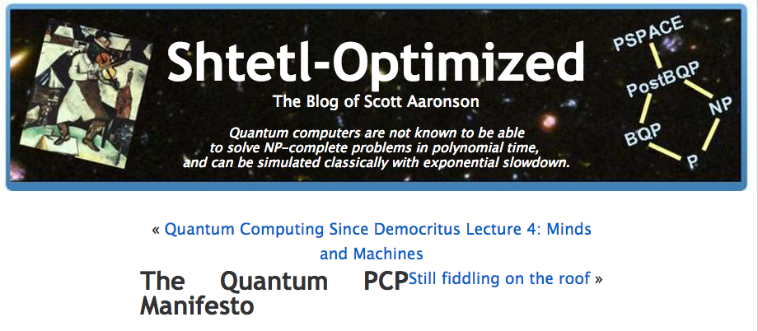
History of the Problem
(Aharonov, Naveh ’02) First mention
(Aaronson’ 06) “Quantum PCP manifesto”

Slide 17
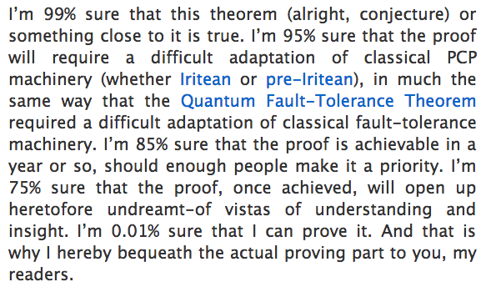
History of the Problem
(Aharonov, Naveh ’02) First mention
(Aaronson’ 06) “Quantum PCP manifesto”

Slide 18
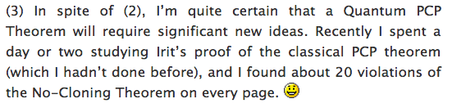
History of the Problem
(Aharonov, Naveh ’02) First mention
(Aaronson’ 06) “Quantum PCP manifesto”

Slide 19
History of the Problem
(Aharonov, Naveh ’02) First mention
(Aaronson’ 06) “Quantum PCP manifesto”
(Aharonov, Arad, Landau, Vazirani ‘08) Quantum version of gap
amplification by random walk on expanders (quantizing Dinur?)

Slide 20
History of the Problem
(Aharonov, Naveh ’02) First mention
(Aaronson’ 06) “Quantum PCP manifesto”
(Aharonov, Arad, Landau, Vazirani ‘08) Quantum version of gap
amplification by random walk on expanders (quantizing Dinur?)
(Arad ‘10) NP-approximation for 2-local (arity 2) almost commuting qCSP

Slide 21
History of the Problem
(Aharonov, Naveh ’02) First mention
(Aaronson’ 06) “Quantum PCP manifesto”
(Aharonov, Arad, Landau, Vazirani ‘08) Quantum version of gap
amplification by random walk on expanders (quantizing Dinur?)
(Arad ‘10) NP-approximation for 2-local (arity 2) almost commuting qCSP
(Hastings ’12; Hastings, Freedman ‘13) “No low-energy trivial states”
conjecture and evidence for its validity

Slide 22
History of the Problem
(Aharonov, Naveh ’02) First mention
(Aaronson’ 06) “Quantum PCP manifesto”
(Aharonov, Arad, Landau, Vazirani ‘08) Quantum version of gap
amplification by random walk on expanders (quantizing Dinur?)
(Arad ‘10) NP-approximation for 2-local (arity 2) almost commuting qCSP
(Hastings ’12; Hastings, Freedman ‘13) “No low-energy trivial states”
conjecture and evidence for its validity
(Aharonov, Eldar ‘13) NP-approximation for k-local commuting
qCSP on small set expanders and study of quantum locally testable codes

Slide 23
History of the Problem
(Aharonov, Naveh ’02) First mention
(Aaronson’ 06) “Quantum PCP manifesto”
(Aharonov, Arad, Landau, Vazirani ‘08) Quantum version of gap
amplification by random walk on expanders (quantizing Dinur?)
(Arad ‘10) NP-approximation for 2-local (arity 2) almost commuting qCSP
(Hastings ’12; Hastings, Freedman ‘13) “No low-energy trivial states”
conjecture and evidence for its validity
(Aharonov, Eldar ‘13) NP-approximation for k-local commuting
qCSP on small set expanders and study of quantum locally testable codes
(B. Harrow ‘13) Approx. in NP for 2-local non-commuting qCSP
this talk

Slide 24
PCP Theorem vs Degree of Graph
For every α, β, γ > 0, it’s NP-hard to determine whether for a
2-CSP of degree Deg and alphabet Σ, unsat = 0 or
unsat > γ|Σ|^{α}/Deg^{β}
Follows easily from PCP + “parallel repetition for kids” (more later)
Ex. Degree 2 interaction graph

Slide 25
PCP Theorem vs Degree of Graph
For every α, β, γ > 0, it’s NP-hard to determine whether for a
2-CSP of degree Deg and alphabet Σ, unsat = 0 or
unsat > γ|Σ|^{α}/Deg^{β}
Follows easily from PCP + “parallel repetition for kids” (more later)
Ex. Degree 2 interaction graph
thm (informal) For any 2-local quantum Hamiltonian on qdits, one can decide in NP whether qunsat(H) = 0 or
qunsat(H) > d^{1/3}/Deg^{1/6}
Unless QMA is contained in NP, the problem is not QMA-hard

Slide 26
“Blowing up” maps
prop For every t ≥ 1 there is an efficient mapping from
(2, Σ, n, m)-csp C to (2, Σ_{t}, n_{t}, m_{t})-csp C_{t} s.t.
(i) n_{t} ≤ n^{O(t)}, m_{t} ≤ m^{O(t)}
(ii) deg(C_{t}) ≥ deg(C)^{t} (iv) unsat(C_{t}) ≥ unsat(C)
(iii) |Σ_{t}|= |Σ|^{t} (v) unsat(C_{t}) = 0 if unsat(C) = 0

Slide 27
Example: Parallel Repetition
(for kids)
(see parallel repetition
session on Thursday)
L
1. write C as a cover label instance
L on G(V, W, E) with function Π_{v,w} : [N] -> [M]
Labeling l : V -> [N], W -> [M] covers
edge (v, w) if Π_{v,w}(l(w)) = l(v)
x₁
x₂
x₃
x_{n}
C₁
C₂
C_{m}
…
2. Define L_{t} on graph G’(V’, W’, E’) with
V’ = V^{t}, W’ = W^{t}, [N’] = [N]^{t}, [M’] = [M]^{t}
Edge set:
Function:
iff

Slide 28
Example: Parallel Repetition
(for kids)
(see parallel repetition
session on Thursday)
Easy to see:
n_{t} ≤ n^{O(t)}, m^{O(t)}
Deg(L_{t}) ≥ deg(C)^{t} ,
unsat(L_{t}) ≥ unsat(C),
|Σ_{t}|= |Σ|^{t} ,
unsat(L_{t}) = 0 if unsat(C) = 0
unsat(L_{t}) ≥ unsat(C)
In fact: (Raz ‘95) If unsat(C) ≥ δ, unsat(L_{t}) ≥ 1 – exp(-Ω(δ³t)
L
1. write C as a cover label instance
L on G(V, W, E) with function Π_{v,w} : [N] -> [M]
Labeling l : V -> [N], W -> [M] covers
edge (v, w) if Π_{v,w}(l(w)) = l(v)
x₁
x₂
x₃
x_{n}
C₁
C₂
C_{m}
…
2. Define L_{t} on graph G’(V’, W’, E’) with
V’ = V^{t}, W’ = W^{t}, [N’] = [N]^{t}, [M’] = [M]^{t}
Edge set:
Function:
iff

Slide 29
Quantum “Blowing up” maps
+ Quantum PCP?

Slide 30
Quantum “Blowing up” maps
+ Quantum PCP?
thm If for every t ≥ 1 there is an efficient mapping from
(2, d, n, m)-qcsp H to (2, d_{t}, n_{t}, m_{t})-qcsp H_{t} s.t.
(i) n_{t} ≤ n^{O(t)}, m_{t} ≤ m^{O(t)}
(ii) Deg(H_{t}) ≥ deg(H)^{t} (iv) unsat(H_{t}) ≥ unsat(H)
(iii) |d_{t}|= |d|^{t} (v) unsat(H_{t}) = 0 if unsat(H) = 0
then the quantum PCP conjecture is false.
Formalizes difficulty of “quantizing” proofs of the PCP theorem
(e.g. Dinur’s proof; see (Aharonov, Arad, Landau, Vazirani ‘08))
Obs: Apparently not related to parallel repetition for quantum games

Slide 31
Entanglement Monogamy…
…is the main idea behind the result.
Entanglement cannot be freely shared
Ex. 1 ,

Slide 32
Entanglement Monogamy…
…is the main idea behind the result.
Entanglement cannot be freely shared
Ex. 1 ,
Ex. 2

Slide 33
Entanglement Monogamy…
…is the main idea behind the result.
Entanglement cannot be freely shared
Ex. 1 ,
Ex. 2
Monogamy vs cloning:
EPR
teleportation
EPR
B₁
B₁
A
B
cloning
A
cloning
B₂
EPR
B₂
A maximally entangled with B₁ and B₂

Slide 34
Entanglement Monogamy…
…intuition:
B₂
B₃
B₁
A can only be substantially entangled with a few of the Bs
How entangled it can be depends on the size of A.
Ex.
A
B_{k}
A

Slide 35
Entanglement Monogamy…
…intuition:
B₂
B₃
B₁
A can only be substantially entangled with a few of the Bs
How entangled it can be depends on the size of A.
Ex.
A
B_{k}
A
How to make it quantitative?
Study behavior of entanglement measures
(distillable entanglement, squashed entanglement, …)
2. Study specific tasks (QKD, MIP*, …)
3. Quantum de Finetti Theorems

Slide 36
Quantum de Finetti Theorems
ρ
=
Let ρ_{1,…,n} be permutation-symmetric, i.e.
Quantum de Finetti Thm:
swap
In complete analogy with de Finetti thm for symmetric probability distributions
But much more remarkable: entanglement is destroyed
(Christandl, Koenig,
Mitchson, Renner ‘05)

Slide 37
Quantum de Finetti Theorems
ρ
=
Let ρ_{1,…,n} be permutation-symmetric, i.e.
Quantum de Finetti Thm:
swap
In complete analogy with de Finetti thm for symmetric probability distributions
But much more remarkable: entanglement is destroyed
(Christandl, Koenig,
Mitchson, Renner ‘05)
Final installment in a long sequence of works: (Hudson, Moody ’76), (Stormer ‘69), (Raggio, Werner ‘89), (Caves, Fuchs, Schack ‘01), (Koenig, Renner ‘05), …
Can we improve on the error?
Can we find a more general result, beyond permutation-invariant states?

Slide 38
General Quantum de Finetti
thm (B., Harrow ‘13) Let G = (V, E) be a D-regular graph with
n = |V|. Let ρ_{1,…,n} be a n-qudit state. Then there exists a globally separable state σ_{1,…,n} such that
Globally separable (unentangled):
l
k
probability
distribution
local states

Slide 39
General Quantum de Finetti
thm (B., Harrow ‘13) Let G = (V, E) be a D-regular graph with
n = |V|. Let ρ_{1,…,n} be a n-qudit state. Then there exists a globally separable state σ_{1,…,n} such that
Ex 1. “Local entanglement”:
For (i, j) red:
But for all other (i, j):
gives good approx.
Red edge: EPR pair
EPR
Separable

Slide 40
General Quantum de Finetti
thm (B., Harrow ‘13) Let G = (V, E) be a D-regular graph with
n = |V|. Let ρ_{1,…,n} be a n-qudit state. Then there exists a globally separable state σ_{1,…,n} such that
Ex 2. “Global entanglement”:
Let ρ = |ϕ><ϕ| be a Haar random state
|ϕ> has a lot of entanglement (e.g. for every region X, S(X) ≈ number qubits in X)
But:

Slide 41
General Quantum de Finetti
thm (B., Harrow ‘13) Let G = (V, E) be a D-regular graph with
n = |V|. Let ρ_{1,…,n} be a n-qudit state. Then there exists a globally separable state σ_{1,…,n} such that
Ex 3.
Let ρ = |CAT><CAT| with |CAT> = (|0, …, 0> + |1, …, 1>)/√2
gives a good approximation

Slide 42
Product-State Approximation
cor Let G = (V, E) be a D-regular graph with n = |V|. Let
Then there exists such that
The problem is in NP for ε = O(d²log(d)/D)^{1/3} (φ is a classical witness)
Limits the range of parameters for which quantum PCPs can exist
For any constants c, α, β > 0 it’s NP-hard to tell whether
unsat = 0 or unsat ≥ c |Σ|^{α}/D^{β}

Slide 43
Product-State Approximation
From thm to cor:
Let ρ be optimal assignment (aka groundstate) for
By thm:
s.t.
Then
unsat(H)

Slide 44
Product-State Approximation
From thm to cor:
Let ρ be optimal assignment (aka groundstate) for
By thm:
s.t.
Then
So
unsat(H)

Slide 45
Coming back to quantum “blowing up” maps + qPCP
thm If for every t ≥ 1 there is an efficient mapping from
(2, d, n)-qcsp H to (2, d_{t}, n_{t})-qcsp H_{t} s.t.
(i) n_{t} ≤ n^{O(t)}
(ii) Deg(H_{t}) ≥ deg(H)^{t} (iv) unsat(H_{t}) ≥ unsat(H)
(iii) |d_{t}|= |d|^{t} (v) unsat(H_{t}) = 0 if unsat(H) = 0
then the quantum PCP conjecture is false.
Suppose w.l.o.g. d²log(d)/D < ½ for C. Then there is a product state φ s.t.

Slide 46
Proving de Finetti Approximation
B₂
B₃
For simplicity let’s consider a star graph
Want to show: there is a state
s.t.
B₁
A
B_{k}

Slide 47
Proving de Finetti Approximation
B₂
B₃
For simplicity let’s consider a star graph
Want to show: there is a state
s.t.
Idea: Use information theory. Consider
B₁
A
B_{k}
mutual info:
I(X:Y) = H(X) + H(Y) – H(XY)
(i)
(ii)

Slide 48
Proving de Finetti Approximation
B₂
B₃
For simplicity let’s consider a star graph
Want to show: there is a state
s.t.
Idea: Use information theory. Consider
B₁
A
B_{k}
mutual info:
I(X:Y) = H(X) + H(Y) – H(XY)
(i)
(ii)

Slide 49
What small conditional mutual info implies?
B₂
B₃
For X, Y, Z random variables
No similar interpretation is known for
I(X:Y|Z) with quantum Z
Solution: Measure sites i₁, …., i_{s-1}
B₁
A
B_{k}

Slide 50
Proof Sktech
Consider a measurement
and
POVM

Slide 51
Proof Sktech
Consider a measurement
and
POVM
There exists s ≤ D s.t.
So
with π_{r} the postselected state conditioned on outcomes (r₁, …, r_{s-1}).

Slide 52
Proof Sktech
Consider a measurement
and
POVM
There exists s ≤ D s.t.
So
with π_{r} the postselected state conditioned on outcomes (r₁, …, r_{s-1}). Thus:
(by Pinsker inequality)

Slide 53
Proof Sktech
Again:
But . Choosing Λ an
informationally-complete measurement:
Conversion factor from info-complete meas.

Slide 54
Proof Sktech
Again:
But . Choosing Λ an
informationally-complete measurement:
Conversion factor from info-complete meas.
Separable state:
Finally:

Slide 55
Product-State Approximation: General Theorem
thm Let H be a 2-local Hamiltonian on qudits with D-regular interaction graph G(V, E) and |E| local terms.
Let {X_{i}} be a partition of the sites with each X_{i} having m sites.
Then there are states ϕ_{i} in X_{i} s.t.
Φ_{G} : average expansion
S(X_{i}) : entropy of
groundstate in X_{i}
X₂
size m
X₁

Slide 56
Product-State Approximation: General Theorem
thm Let H be a 2-local Hamiltonian on qudits with D-regular interaction graph G(V, E) and |E| local terms.
Let {X_{i}} be a partition of the sites with each X_{i} having m sites.
Then there are states ϕ_{i} in X_{i} s.t.
Φ_{G} : average expansion
S(X_{i}) : entropy of
groundstate in X_{i}
Degree
Average Expansion
Average entanglement
X₂
size m
X₁

Slide 57
Summary and Open Questions
Summary:
Entanglement monogamy puts limitations on quantum PCPs
and on approaches for proving them.
Open questions:
Can we combine (BH ‘13) with (Aharonov, Eldar ‘13)? I.e. approximation for highly expanding non-commuting k-local models?
(Needs to go beyond both product-state approximations and Bravyi-Vyalyi)
Relate quantum “blowing up” maps to quantum games?
Understand better power of tensor network states (product states 1st level)
(dis)prove quantum PCP conjecture!

Slide 58
Summary and Open Questions
Summary:
Entanglement monogamy puts limitations on quantum PCPs
and on approaches for proving them.
Open questions:
Can we combine (BH ‘13) with (Aharonov, Eldar ‘13)? I.e. approximation for highly expanding non-commuting k-local models?
(Needs to go beyond both product-state approximations and Bravyi-Vyalyi)
Relate quantum “blowing up” maps to quantum games?
Understand better power of tensor network states (product states 1st level)
(dis)prove quantum PCP conjecture!
Thanks!

