Slide 1



What is nonclassical about uncertainty relations?
CEQIP 2023
Giovanni Scala
giovanni.scala@ug.edu.pl
With L. Catani, M. Leifer, D. Schmid, and R. W. Spekkens,
Phys. Rev. Lett. 129, 240401, 2022 (arXiv: 2207.11779)
Notes:
What is nonclassical about uncertainty relations? Firstly, we pose the attention on the word *nonclassical*. and why then this is a meaningful question. After all it has always been taught to us that uncertainty relations are a main feature of quantum theory that state a departure from the classical worldview.
(Well, are we sure that this is really the case? To answer the question we need to first define a valid notion of nonclassicality. In quantum foundations one of the main area of research is to understand what constitute a valid notion of classicality and nonclassicality. There are criteria, and generalized noncontextuality, that we adopt here, satisfies all of them. )

Slide 2
What is meant by nonclassical ?

Slide 3
Some common answers:
Teleportation
Remote steering
No-cloning
Entanglement
Wave-particle duality
Nonlocality
Quantum interference
Coherent superposition
Uncertainty relations
Notes:
Here let me mention some common answers that you often hear.
Or also things that are now part of the folklore and that even non-expert have heard about concerning the weirdness of quantum theory.
Last week I met my cousin made tattoos and he told me that a client was asking for some weird tattous about quantum theory.
Of course, he mention something about entanglement… and I was force to confirm that entanglement is a very nonclassical feature, indeed you can have this very correlated states and do crazy things with it. Then he mentioned also superposition, quantum interference.
(For example what was taught to me in school. I don’t know if you hade the same experiences.)
Quantum interference in the implementation of two-slit experiment even famously claimed to capture the only mystery of quantum theory.
Then blabla, Just to name a few also because I finished the colors to use. After few minutes of discussion, he decided to draw a different kind of tattoo to his client.
But the point I wanted to make here is that this picture looks quite confusing. Can we single out the feature that establishes the mystery, or I would say the conceptual innovation of quantum theory with respect to the classical world view? Or, at least, can we formulate criteria for a good notion of classicality, and so of nonclassicality?

Slide 4
What constitute a good notion of classicality?
Notes:
Here we are interesting on the foundations of quantum theory. So, I think it’s good to spend some time on which criteria constitute a good notion of classicality.
Having in mind that we want to understand the conceptual innovation of quantum theory with respect to the classical worldview with it. So distill the mysterious aspect, the essence of quantum theory with it.

Slide 5
Criteria for a good notion of classicality
Mathematical notion establishing a boundary between what is interpretationally problematic and what is not.
Applicable to a broad range of physical scenarios.
Subject to direct experimental test.
Constitutes a resource.
Notes:
Mathematically rigorous definition that you can prove theorems and no-go theorems with. Mathematical notion that endorses a principle establishing a boundary between what is interpretationally problematic and what is not.
(SAY previous slide Because remember our goal is to show what is the conceptual innovation of quantum theory with respect to the classical worldview.)
Endorsing a principle also obeyed by classical physics otherwise it wouldn’t be a notion of classicality, but it’s not just relegated to that. We want to distill the mystery/ the conceptual innovation of quantum theory with respect to the classical worldview and so be more permissive with what is the notion of classicality.
A principle we think our scientific theory should obey, otherwise it’d constitute an interpretational problem. Somehow its violation has to capture what constitutes a mystery.

Slide 6
Noncontextuality
Preparation Noncontextuality

Slide 7
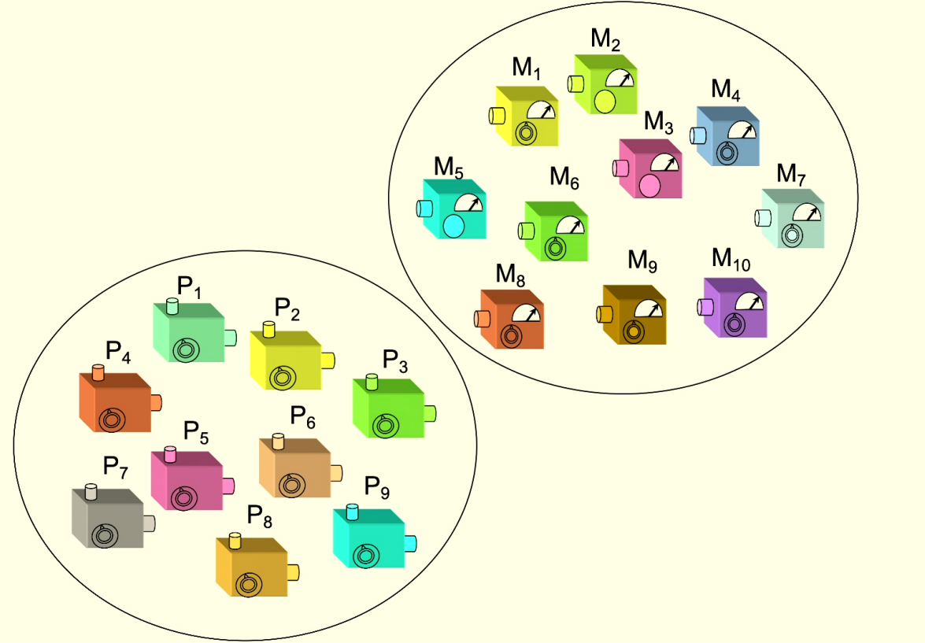





Operational equivalence classes of preparations
R. Spekkens | PIRSA
Notes:
Imagine a prepare and measure scenario.
Define any letter appearing in the slide.
Operational equivalence. For example in quantum theory two possible convex mixtures that give the completely mixed state of a qubit represent two operationally equivalent preparations. Two contexts.
Noncontextuality is the requirement that operational equivalences imply ontological equivalences.
I assume here a basic knowledge of what is an operational theory and an ontological model (or hidden variable model).
Quantum theory does not admit of a preparation noncontextual ontological model.
Still it is interesting that there exist theories that admit of a noncontextual model but that manifest some of the properties I mentioned in the previous slide.
Preparation noncontextuality implies outcome determinism for sharp measurements.
The idea motivating this notion is that the best explanation for two preparations procedures that cannot be operationally distinguished in principle, by any measurement or transformation, is that they are the same object.
Same for Measurements and Transformations. If they give me the same statistics I say they are equivalent. No go theorem also for transformations. Not for measurements.
Universally i.e. prep NC, meas NC, transf NC.

Slide 8
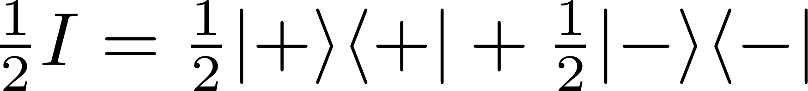
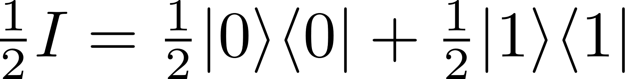

Example from quantum theory

Slide 9
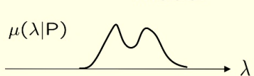

Preparation noncontextual model

Slide 10

Preparation contextual model

Slide 11
In a preparation noncontextual ontological model

Slide 12
Criteria for a good notion of classicality
Mathematical notion establishing a boundary between what is interpretationally problematic and what is not.
Applicable to a broad range of physical scenarios.
Subject to direct experimental test.
Constitutes a resource.

Slide 13
Criteria for a good notion of classicality
Instance of Leibnizian methodological principle / no fine-tuning.
Applicable to a broad range of physical scenarios.
Subject to direct experimental test.
Constitutes a resource.
Notes:
Say again the def on Leibnizianity and why it establishes a principle between what is intepretationally problematic and not. i.e. because basically it’s a no-conspiracy principle for what constitutes a good realist explanation of a physical theory.

Slide 14
Criteria for a good notion of classicality
Instance of Leibnizian methodological principle / no fine-tuning.
Applicable also to single qubit; subsumes other notions.
Subject to direct experimental test.
Constitutes a resource.
Notes:
Applies to a broad class of physical scenarios. For ex a single system unlike locality. And single qubit unlike KS. Also it does not assume QT, and it is reobtained in the limit of sufficient noise or coarse graining or decoherence.
Subsumes all. Proof of nonlocality can be turned into a proof of contextuality. KS noncontextuality is measurement noncontextuality + outcome determinism for sharp measurements. Also connected to positivity of quasirep which is very important in quantum optics.
Simplex embeddability is the notion of classical explainability in GPTs.

Slide 15
Criteria for a good notion of classicality
Instance of Leibnizian methodological principle / no fine-tuning.
Applicable also to single qubit; subsumes other notions.
It is empirically testable.
Constitutes a resource.

Slide 16
Criteria for a good notion of classicality
Instance of Leibnizian methodological principle / no fine-tuning.
Applicable also to single qubit; subsumes other notions.
It is empirically testable.
Its violation is connected to quantum computational advantages.
For more, see David Schmid’s lectures at Solstice of Foundations.
Notes:
Quantum computation, cryptography, metrology, communication, state-discrimination, cloning, …

Slide 17
What is nonclassical about uncertainty relations?
CEQIP 2023
Giovanni Scala
giovanni.scala@ug.edu.pl
With L. Catani, M. Leifer, D. Schmid, and R. W. Spekkens,
arXiv: 2207.11779 (Phys. Rev. Lett. 129, 240401, 2022)
Notes:
So if we come back to the title now that we have our preferred notion of classicality in hand, what it really means is:

Slide 18
What is contextual about
uncertainty relations?
CEQIP 2023
Giovanni Scala
giovanni.scala@ug.edu.pl
With L. Catani, M. Leifer, D. Schmid, and R. W. Spekkens,
arXiv: 2207.11779 (Phys. Rev. Lett. 129, 240401, 2022)

Slide 19
Motivation
There exist noncontextual theories that manifest uncertainty relations.
Which aspects of uncertainty relations witness contextuality?
Notes:
And now that we have the right notion of classicality really comes the motivation for asking this question. So you thought that the existence of UR constitutes an instance of true nonclassicality, but that is not true! CREATE TENSION AND AWARENESS. SURPRISE EFFECT. CREATE CURIOSITY FOR SOMETHING THAT I’LL SHOW ONLY AT THE END.
Which aspects of uncertainty relations, if any, witness nonclassicality, here in the form of contextuality?

Slide 20
Contents
Uncertainty relations
What aspect of uncertainty relations witnesses contextuality

Slide 21
Contents
Uncertainty relations
What aspect of uncertainty relations witnesses contextuality

Slide 22
“Product” uncertainty relations in quantum theory
H.P. Robertson (1903-1961)
W. Heisenberg (1901-1976)
Notes:
1) Heisenberg-Robertson UR bounds the variances of two observables with the expectation value of their commutator (also Schrodinger improved this, but still has the same problem below).
About joint predictability of two measurements on a state. So like us, not like error-disturbance UR, about trade-off between info gain and disturbance.
2) However these are unsatisfactory in the finite dimensional case.
Both expectation value of variances are calculated on a state psi. So imagine that A and B are Pauli X and Z, and you choose as psi one of their eigenstate, e.g. of X, then this uncertainty relation is trivial. Even if the measurements are incompatible and have a tradeoff relation on their predictabilities for that state.
(Pair of measurements for which there is a nontrivial tradeoff in their predictabilities.
UR express limits on the extent to which the outcomes of distinct measurements on a single state can be made jointly predictable.)

Slide 23


“Sum” uncertainty relations in quantum theory
In the case of Pauli X and Z measurements,
Predictability relations
Notes:
A solution to the above is to consider sums instead of products. For this talk we consider Pauli X and Z measurements, that are complementary and are the discrete analogue of position and momentum. In general, our results will hold for any two binary-outcome measurements.
This tradeoff relation holds for any state in quantum theory, and so it is an uncertainty relation. Its validity comes from the fact that it is a description of the Bloch ball of qubit quantum states.
Other versions of these are the entropic UR. Connected to ours, but we do not deal with them. I can spend some words later on them.

Slide 24
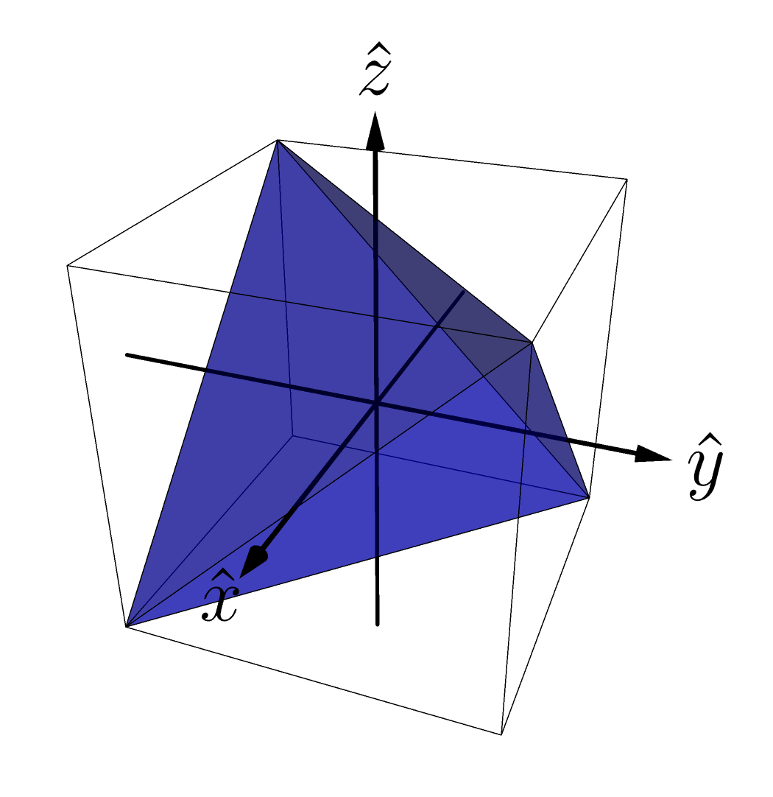
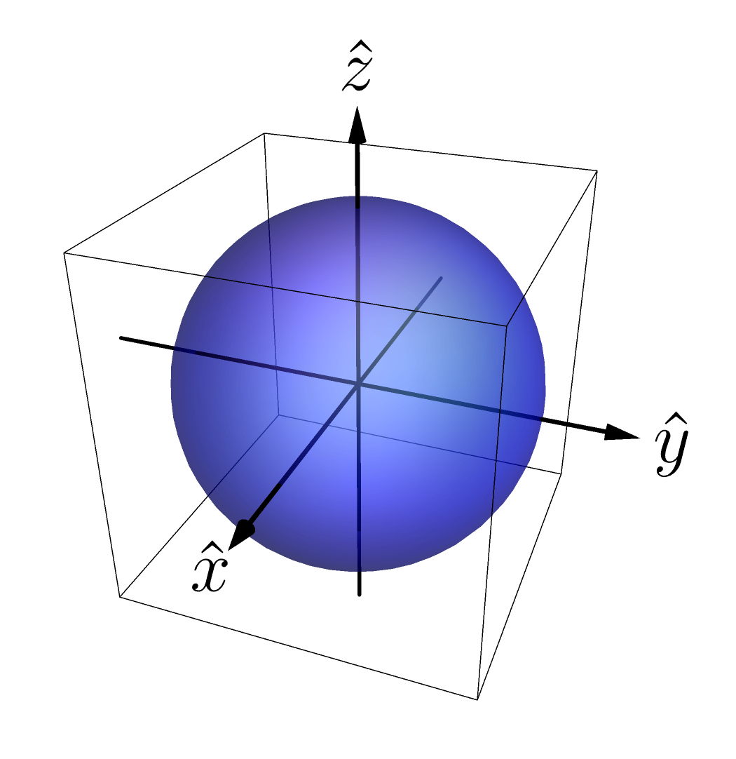
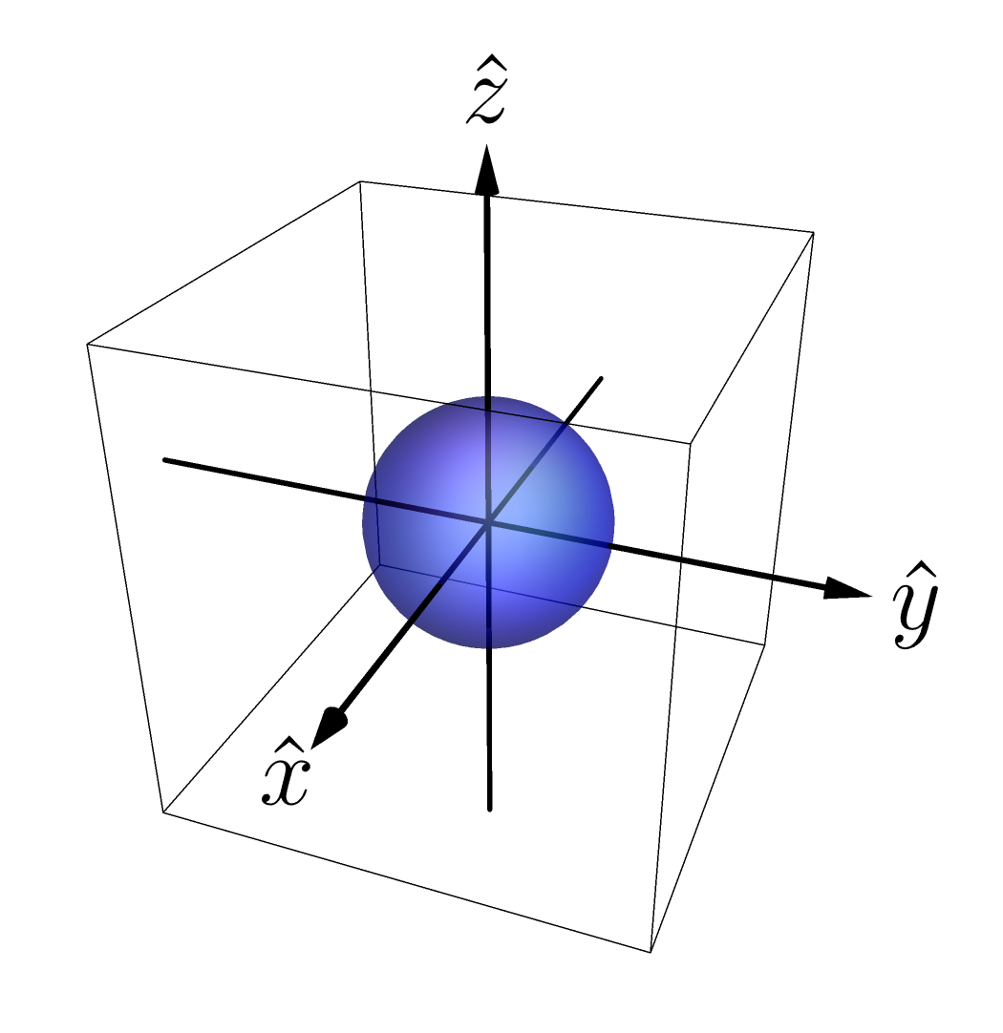
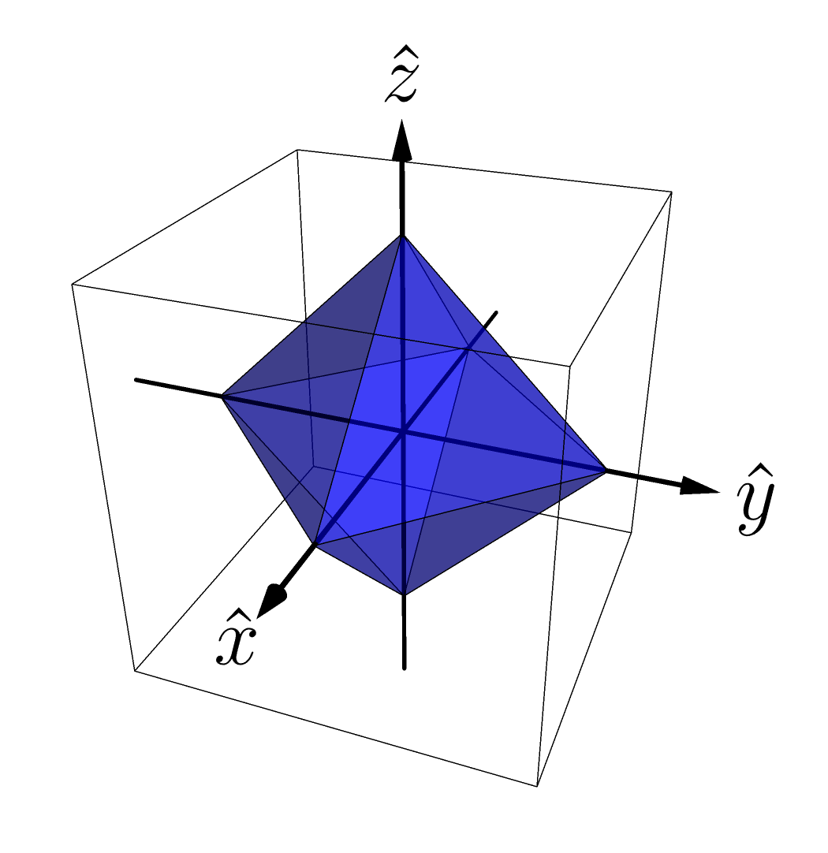
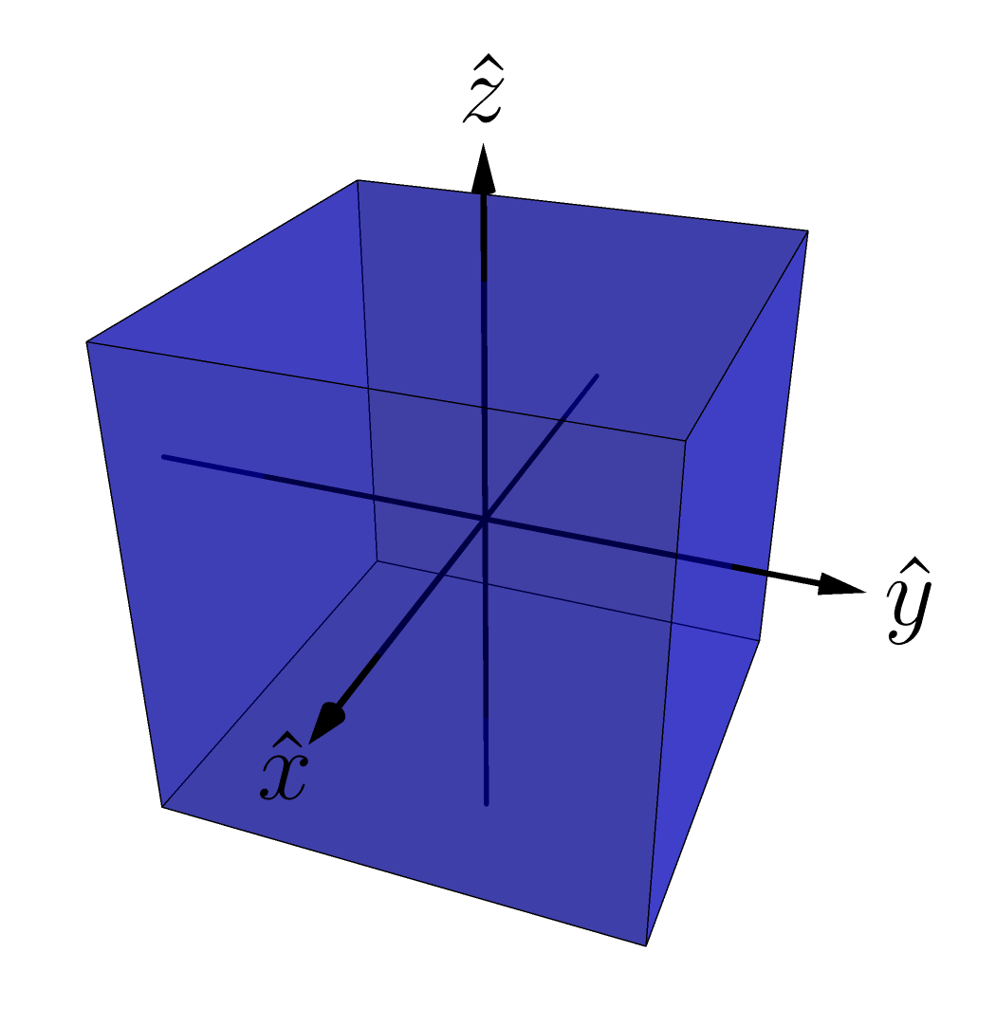
Operational theories – examples
Gbit theory
depolarized qubit theory
Stabilizer theory
Simplicial theory
Qubit theory
Notes:
In particular we consider simple examples. We start with the state-space representation of the qubit, which is the standard Bloch sphere. In R3 we represent a 4-dimensional space of Hermitian operators. Every qubit operator is represented as a linear combination of elements of a basis of the 4-dimensional space of Hermitian operators.
The expectation values of X and Z are linearly related to the probability of getting X and Z, and so with the projections of the state space on those axes.

Slide 25
Examples: comparison of uncertainty relations
Notes:
The ii is gonna be clear in a bit why it’s red. For now imagine that they’re all blue. Predictability of X and of Z plotted.
The expectation values of X and Z are linearly related to the probability of getting X and Z, and so with the projections of the state space on those axes.
Quantum UR is represented by the section of a circle.

Slide 26
Contents
Uncertainty relations
What aspect of uncertainty relations witnesses contextuality

Slide 27
How to link uncertainty relations and contextuality?
Problem:
Uncertainty relations single state.
Contextuality requires operational equivalences (at least 4 states).
Notes:
An UR expresses the predictability tradeoff between two measurements for any single state in the theory.
Contextuality requires at least 4 states (and two tomographically complete measurements like X and Z here).

Slide 28
How to link uncertainty relations and contextuality?
Solution:
Notes:
Consider operational theories with a pair of joint measurements, denoted X,Z, and a state that satisfies the condition of A12 orbit realizability.

Slide 29
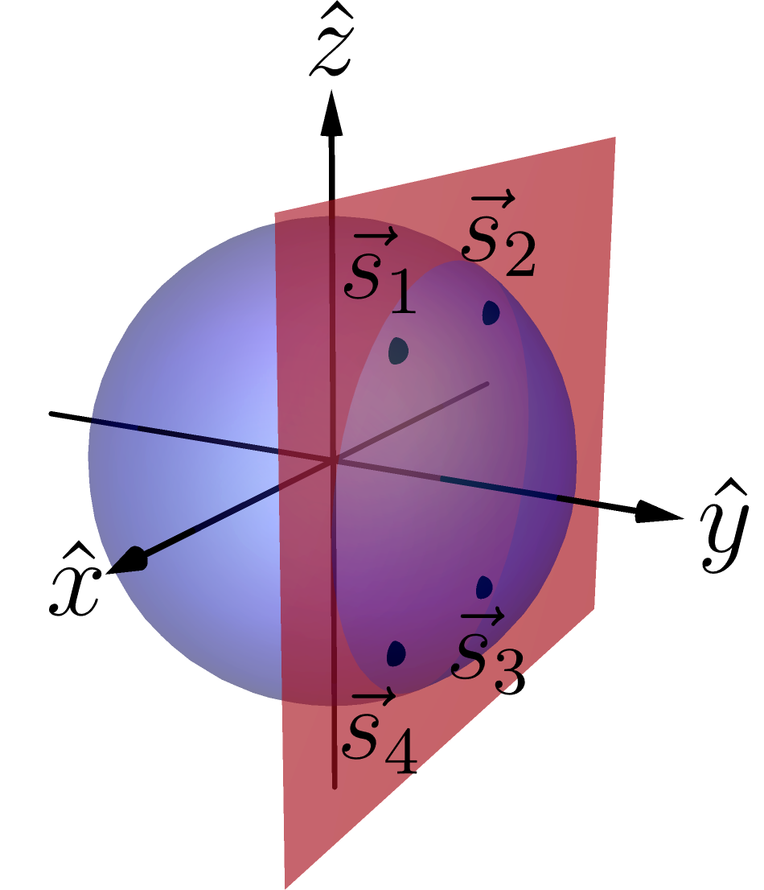
The state has equal predictability counterparts.
The state manifest operational equivalences with such counterparts.
Example in the qubit theory:
Notes:
i.e. there exists other states (at least other 3) that have the same predictabilities, in modulus, for X and Z. Other states manifest those predictabilities, so they also show the same uncertainty relation!
i.e. among these states there are at least 3 with which the state can have operational equivalence. Moreover, among these states there are operational equivalences.
So they lie in a rectangle in a plane parallel to the ZX plane. These vertices are the orbit of the original state under the action of the symmetry group of a rectangle under reflections, the Coxeter group A21. That’s why the name.
Basically it’s a rectangle condition.

Slide 30


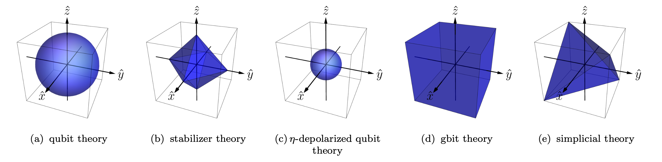
Theories with
If all states in an operational theory satisfy the condition of
we say that the theory has .
Examples:
Notes:
They all satisfy apart from simplicial. The set of states satisfying the A12 symmetry forms an octahedron inside the tetrahedron, whose vertices are at the midpoints of the edges, i.e. the stabilizer octahedron.
The vertices of the tetrahedron do not satisfy the symmetry, as they don’t manifest operational equivalences.
Notice, however, that our result applies to any theory with some state having A12 symmetry. Not only the theories that have all states satisfying it.

Slide 31

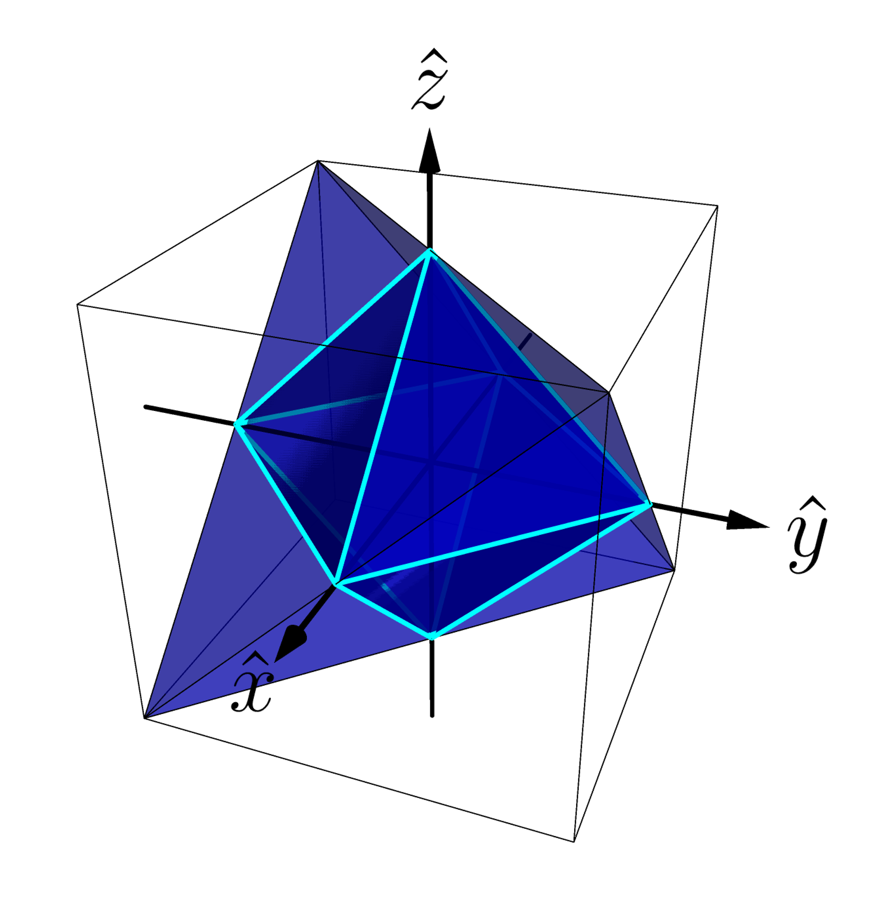
Noncontextuality and uncertainty relations
Notes:
So noncontextuality implies the functional form of the uncertainty relation to be below a linear curve.
Our bound is a universal constraint on the predictability tradeoff within such theories.

Slide 32
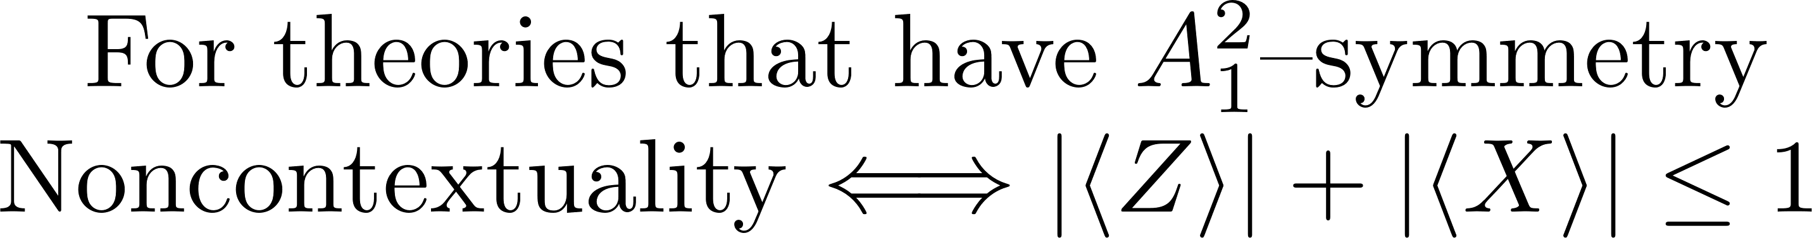
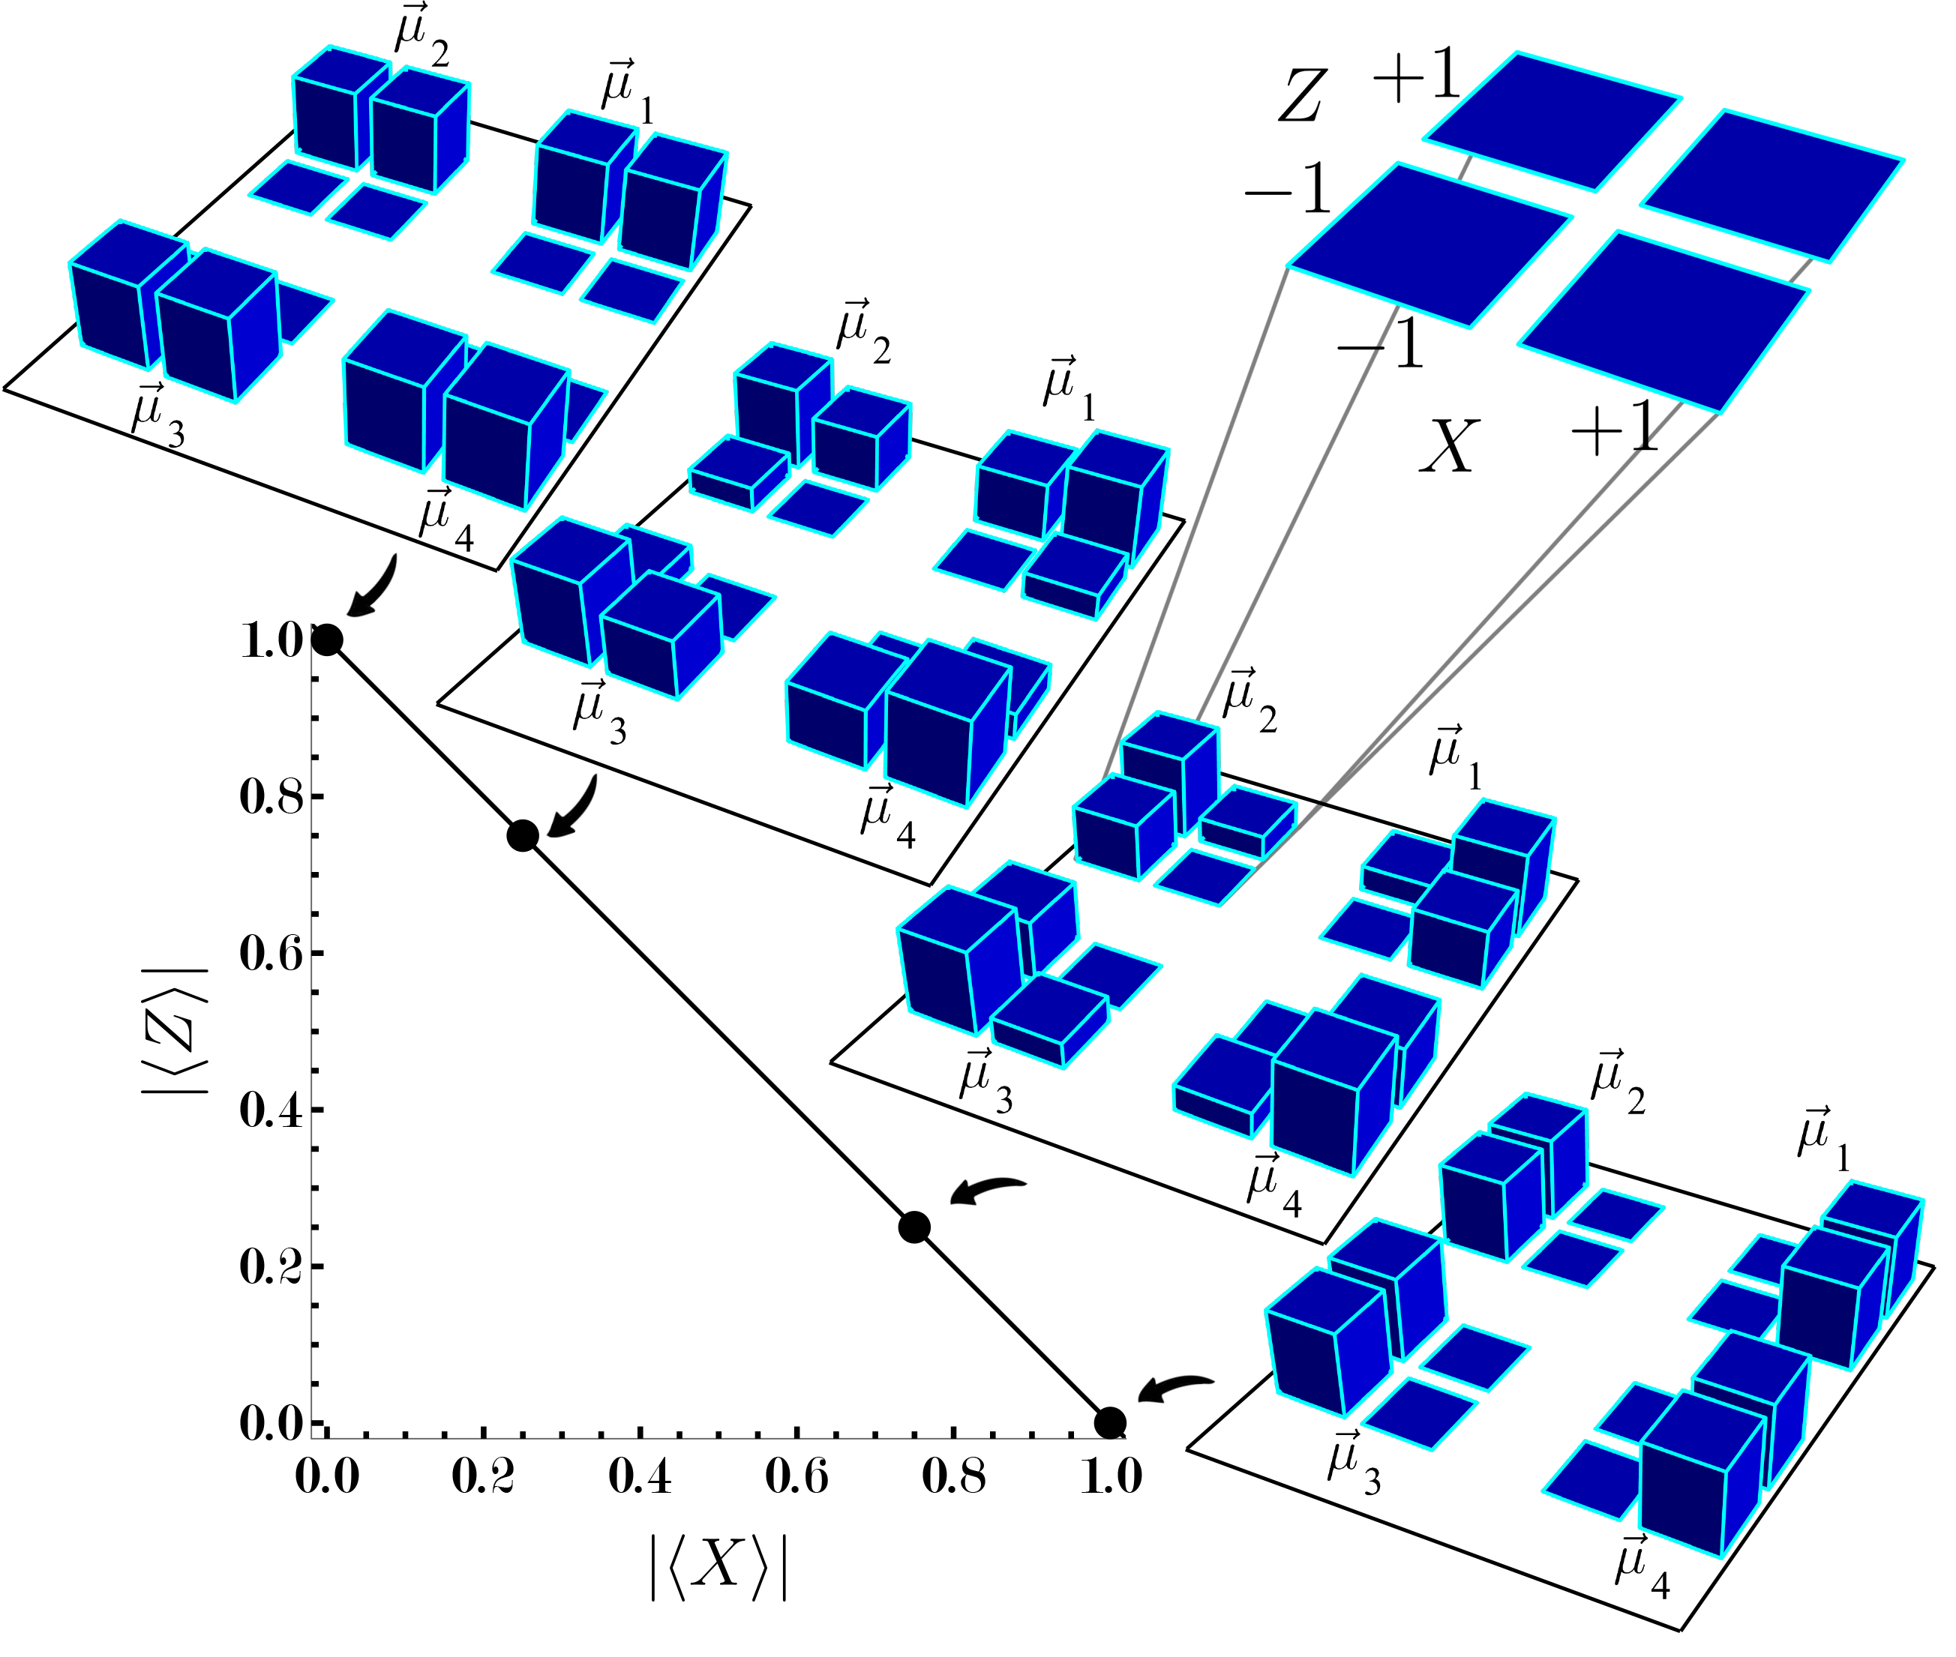

Slide 33

Comparison of uncertainty relations
Notes:
So noncontextuality implies the functional form of the uncertainty relation to be below a linear curve.
Notice that the NC bound intersects the quantum ZX UR only for X=1 and Z=0 or vice versa. This is what happens in the toy theory. Max predictability of X and zero of Z or vice versa. Otherwise the qubit can violate the bound and indeed shows contextuality.
Stabilizer UR as noncontextuality inequality.
Qubit maximum violation of the bound is sqrt{2} and gbit is 2. Geometrically easy to see.
Notice that in the case of the simplicial theory, our bound is not a universal constraint on the predictabilities of the theory. Only in the subset of states that satisfy the symmetry, and that indeed satisfy our bound, consistently with the fact that the simplicial theory admit of a noncontextual model.
The vertices, that allow to beat our bound and provide the UR for the simplicial theory, do not satisfy the symmetry and so are not subjected to our result.

Slide 34
The functional form of an uncertainty relation can witness contextuality.
Notes:
And so if we come back to the original question “bla bla” the answer is that such an aspect is…/
Not the mere existence of UR!
Under the condition of A1^2 orbit realizability noncontextuality bounds the functional form of the ZX predictability tradeoff below a linear curve.
For theories where this condition applies to all states, the predictability tradeoff is an UR and so it is the functional form of UR that can witness contextuality.
So coming back to what aspects of uncertainty relations witness nonclassicality, the answer is: it is the functional form above the linear curve of quantum UR that captures its nonclassicality. At least in the sense of contextuality.

Slide 35

Notes:
And there’s a surprising consequence associated with this result.
It is usually thought that the lack of perfect predictability that witness nonclassicality, e.g. in quantum theory. However if one takes nonclassicality as contextuality, it is quite different. It is the greater joint predictability for states satisfying the A12 symmetry that witness nonclassicality.

Slide 36

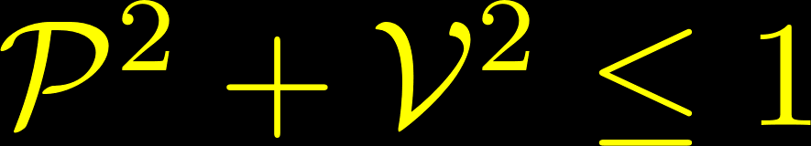


What is nonclassical about quantum interference?
L. Catani, M. S. Leifer, D. Schmid, R. W. Spekkens, arXiv: 2111.13727 (2021).
L. Catani, M. S. Leifer, G. Scala, D. Schmid, R. W. Spekkens, PRA 108,022207 (2023) (arXiv: 2211.09850)i
Notes:
Where V and P are expectation value of X and of Z. V captures the wave like property and P captures the particle like property.
There are some caveats, e.g. this result works for theories, like QT, that satisfy a particular symmetry condition, and the result leverage the result of this other paper.
The mere existence of wave-particle duality relations does NOT constitute a proof of nonclassicality. In particular the toy field theory was reproducing these two points. It is the particular functional form of them greater than linear that does.
So you go to the lab, you perform your interference experiment (being sure you satisfy also the symmetry condition), if your visibility and distinguishability violate the NC bound, then you know that you’re witnessing true nonclassical interference phenomena.

Slide 37
Extra slides

Slide 38
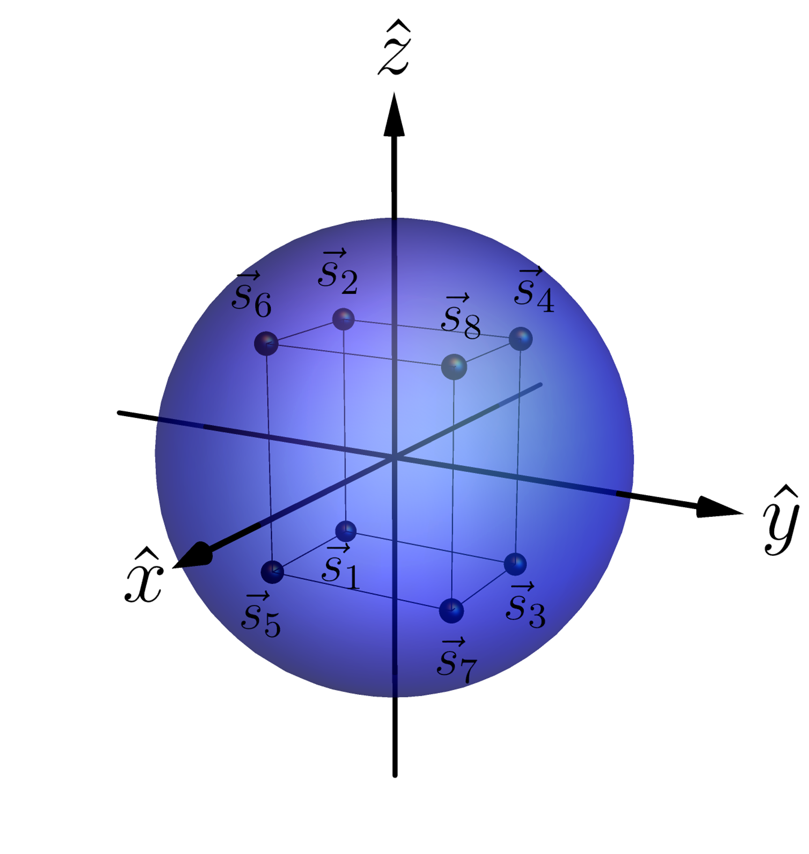
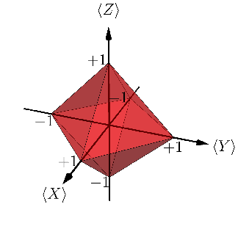
Generalization to three measurements
Notes:
Noise robust. It can be tested experimentally.
So the UR it’s a NC inequality. It’s not about a single state as you could pick any in the A12 orbit realizability.

Slide 39
Some references
This work :
Epistemically restricted theories :
What’s truly nonclassical about quantum theory :
L. Catani, M. S. Leifer, D. Schmid, R. W. Spekkens, arXiv: 2111.13727 (2021).
R. W. Spekkens Phys Rev A 75 (3): 032110 (2007).
S. Bartlett, T. Rudolph, R. W. Spekkens, Phys Rev A 86, 012103 (2012).
R. W. Spekkens, in Quantum Theory: Informational Foundations and Foils, pp 83-135, Springer Dordrecht (2016).
L. Catani, D. E. Browne, New J. Phys. 19, 073035 (2017).
L. Catani, M. S. Leifer, arXiv:2003.10050 (2020).
D. Schmid, J. Selby, R. W. Spekkens, arXiv:2009.03297 (2020).

Slide 40
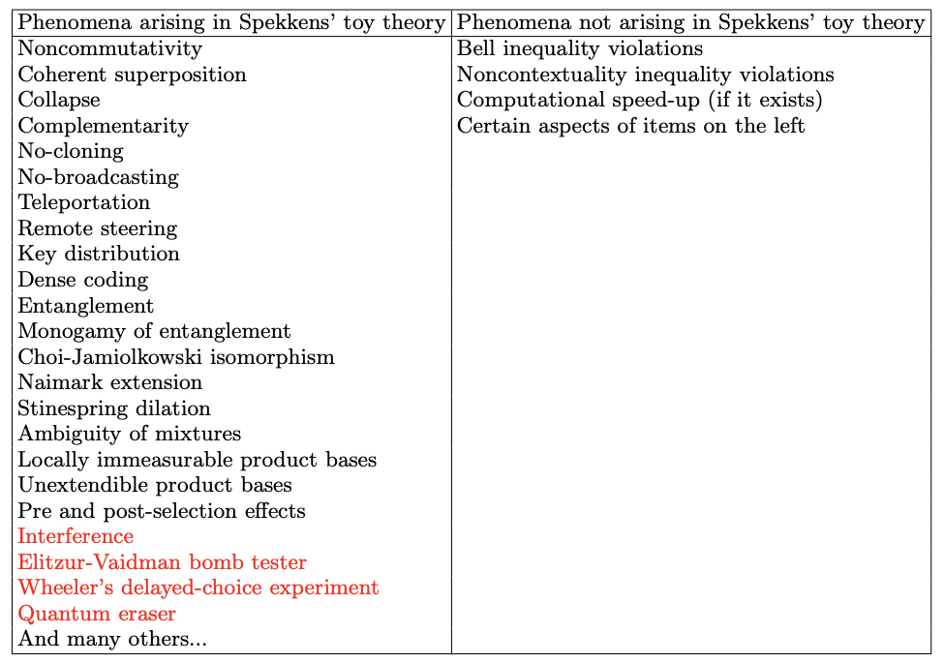
Further motivation
Motivation
R. W. Spekkens, in Quantum Theory: Informational Foundations and Foils, pp 83-135, Springer Dordrecht (2016).
*L. Catani, M. Leifer, D. Schmid and R.W. Spekkens, arXiv:2111.13727 (2021).
Notes:
The red ones are novel with respect to the table in Spekkens’ paper.

Slide 41
Operational theories
Operational theory in a prepare and measure scenario:
Preparation
Measurement and outcome
Predicted statistics
Notes:
An operational theory in a prepare and measure stipulates the preparations the measurements and an algorithm for computing the predicted probabilities of an outcome given preparation and measurement for all possible preparations and measurements.
We can imagine that each preparation and measurement effect as a real-valued vectors, and the probability is given by their inner product.

Slide 42
Ontological models and Noncontextuality
Ontological model of an operational theory
Each system ontic state space describing possible ontic states .
Preparation
Measurement and outcome
Predicted statistics
15/27
Notes:
The theory predicts well because there’s actual system that is subjected to the experimental procedures. It has physical properties defined as ontic states.
Since we consider Lambda finite, we can represent the probability distributions as vectors.

Slide 43
Ontological models and Noncontextuality
Preparation noncontextuality
Two preparations are operationally equivalent, , if
In a preparation noncontextual ontological model,
In particular,
R.W. Spekkens, Phys. Rev. A 71, 052108 (2005)
16/27
Notes:
Where the w_i are probability distributions.
I presented the notion for preparations but it extends also to transformations and measurements and it is known as generalized contextuality.
Of the examples before, qubit QT, gbit theory and eta-depolarizing qubit theory when eta less than 2/3 do not admit of NC ontological model. Simplicial and stabilizer yes.

